Slide 1
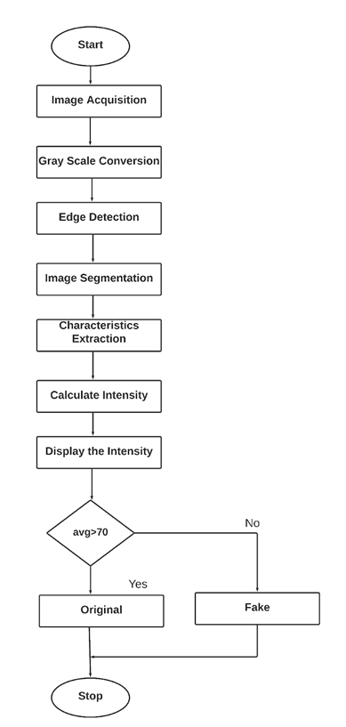
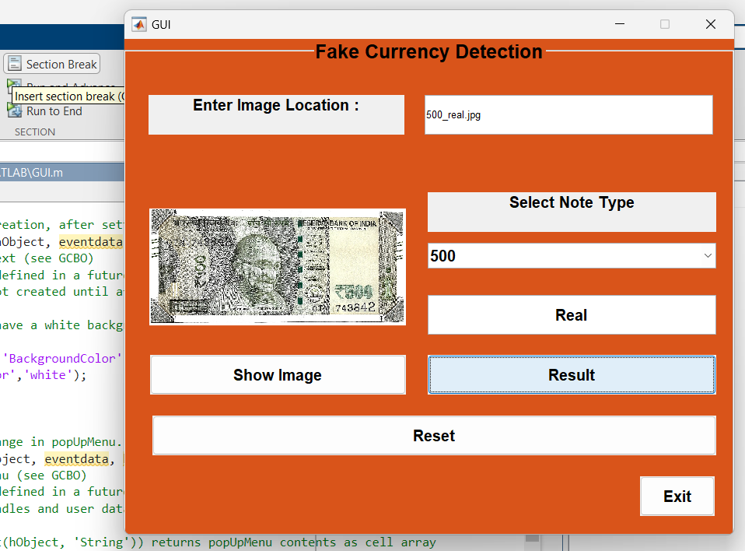
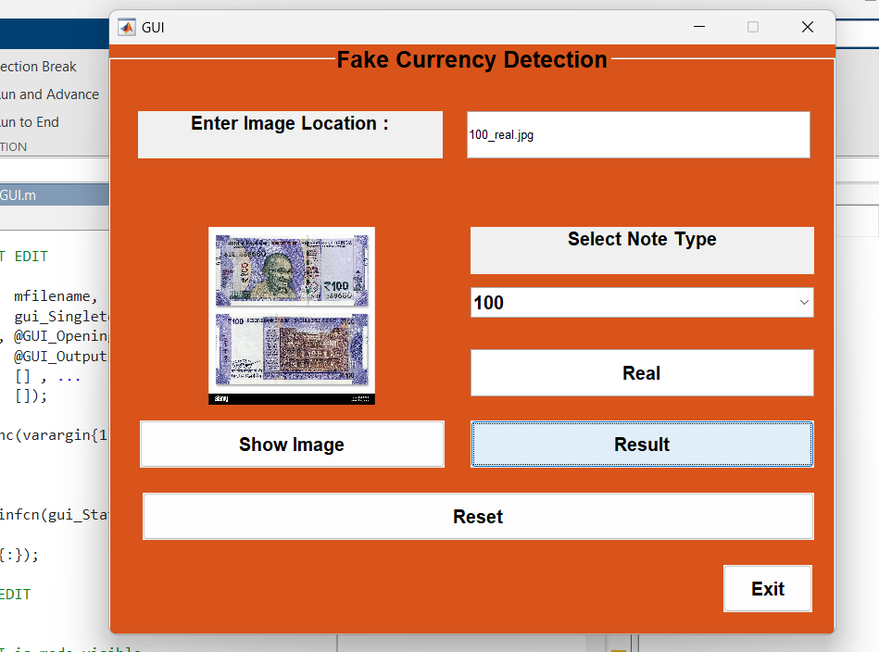
FAKE CURRENCY DETECTION USING MAT LAB
B.PRANITH ,CH.ABHILASH,P.SRIRAM,N.RAHUL
DEPARTMENT OF ECE, CMR TECHNICAL CAMPUS
Abstract
Block Diagram
Results
Conclusion
The advancement of color printing technology has increased the rate of fake currency note printing and duplicating the notes on a very large scale. Few years back, the printing could be done in a print house, but now anyone can print a currency note with maximum accuracy using a simple laser printer. As a result, the issue of fake notes instead of the genuine ones has been increased very largely. India has been unfortunately cursed with the problems like corruption and black money. And counterfeit of currency notes is also a big problem to it. This leads to design of a system that detects the fake currency note in a less time and in a more efficient manner. The proposed system gives an approach to verify the Indian currency notes. Verification of currency note is done by the concepts of image processing. . MATLAB software is used to extract the features of the note. The proposed system has got advantages like simplicity and high-performance speed. The result will predict whether the currency note is fake or not.
So, here are the some results of the project
The fake currency detection using image processing was implemented on MATLAB. This MATLAB GUI application provides a user-friendly interface for loading, displaying, and processing images. It demonstrates basic GUI functionalities, including handling user inputs, displaying images, and managing application state through various callback functions.
INTRODUCTION
The detection of fake currency is a critical issue that affects economies worldwide. As counterfeiters employ increasingly sophisticated methods, traditional manual detection techniques often fall short. This project leverages MATLAB to develop an automated system for fake currency detection, utilizing advanced image processing and pattern recognition algorithms. MATLAB, with its powerful computational and visualization capabilities, offers an ideal environment for creating robust and efficient detection systems. This documentation outlines the project's objectives, methodologies, and implementaion details.
Future Scope
The future several avenues for fake currency detection using MATLAB with a GUI is promising, with several avenues for enhancement and expansion:Advanced Image Processing Techniques, Multi-Sensor Fusion, Real-time Detection, Database Integration,, Security and Privacy, Collaborative Research, International Currency Support, Mobile and Web Applications.

